Slide 1


Permanence Planning Overview
Social Work Teams
Fostering & Adoption Services
Panels
Family & Friends Service
Family Group Conferencing
Lifelong Links
Permanency planning is important for all children and young people. There are a range of different permanency planning support service. This documents aims to provide an overview of these services including:
Interventions to support children to safely remain with their parents
Exploration of wider family networks through genogram work
Family Group Conferences
Planning for permanent alternative care arrangements
Our children and young people

Slide 2

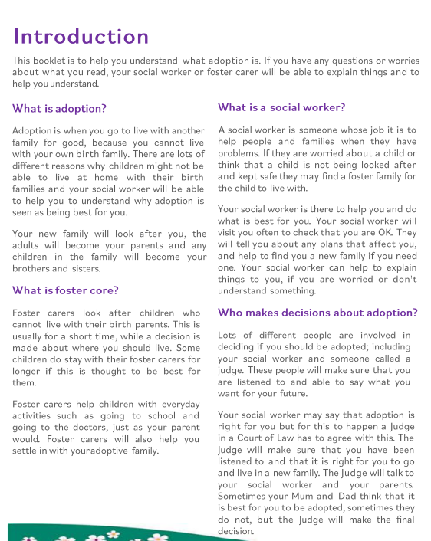
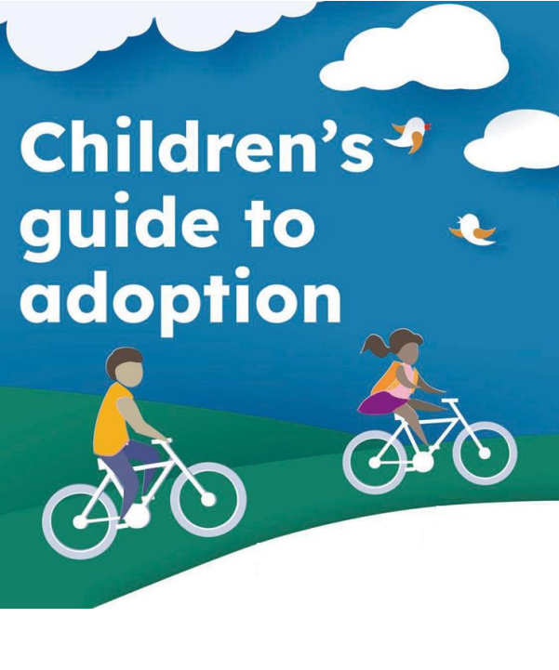
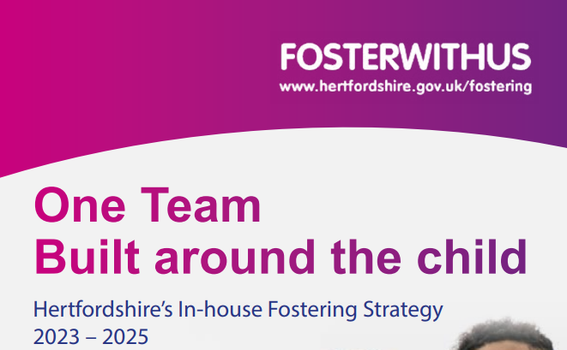
Social Work Teams and Fostering & Adoption Services
Senior managers for both the children’s Social Work Teams and the Fostering & Adoption Services have detailed oversight of children’s permanency plans and review progress against these.
Social Work Teams
Develop and implement children’s care plans
Fostering and Adoption Services
Supporting assessment , matching, approval and post placement support for children and carers/adopters

Slide 3

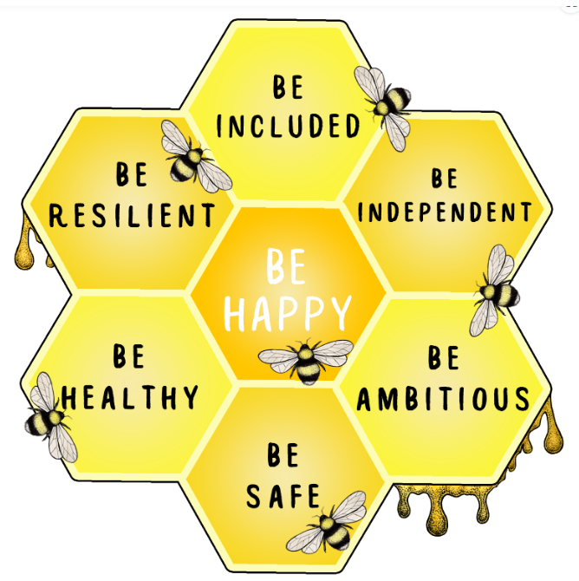
Panels
Panels
There are numerous panels which support permanency considerations for our children and young people. These panels help to keep our outcome in focus
Practice and Resources Panel (P.A.R.P.). The Panel oversees and provides case direction/decisions about children on the edges of care and admission to care, including directions for exploration of wider family network options for children through Family Group Conferencing and viability assessments.
Adoption Panel /ADM for best interests and adopter approval
Foster Panel/ADM for long term match approvals

Slide 4


Family & Friends Service
Family & Friends Service
Assessment, approval and support of foster carers who are relatives of/or adults who have a close connection to the child.
SGO assessments and support to achieve permanency within the family network for children under a Special Guardianship Order

Slide 5

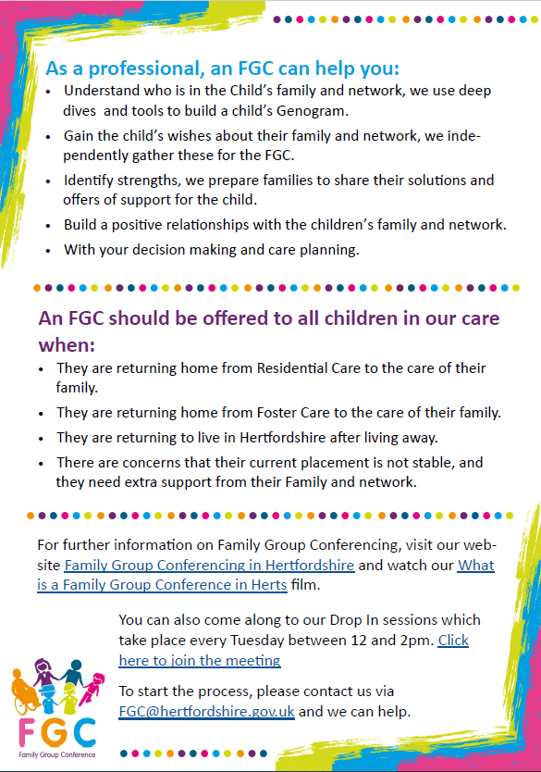
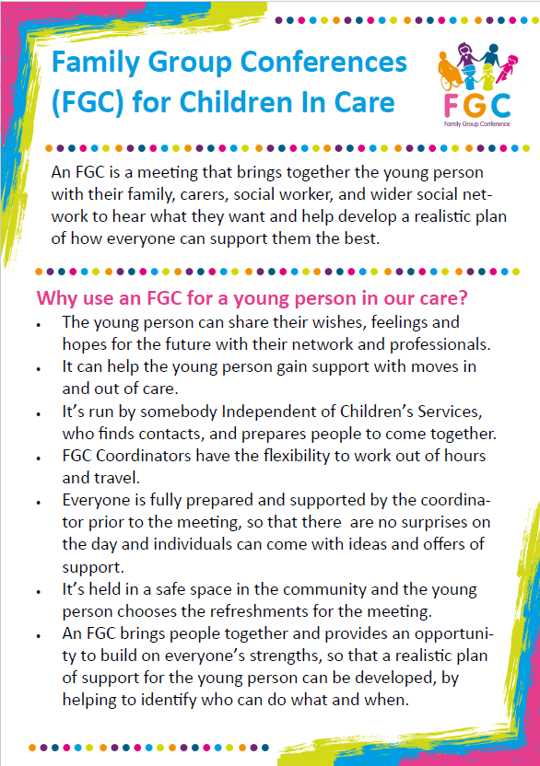
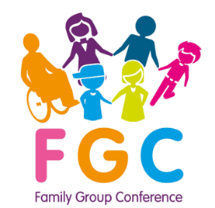

Family Group Conferences & Lifelong Links
FGC service
Meetings that brings together the young person with their family, carers, social worker, and wider social network to hear what they want and help develop a realistic plan of how everyone can support them the best.
Lifelong Links
A child centred process with the aim of establishing lasting connections and support networks early in a young person's care journey to provide stability and support throughout their time in care and into independent living and beyond.

